Slide 1


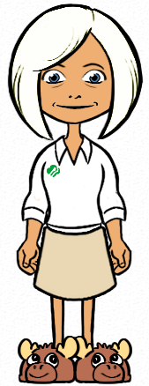





Volunteer Level Access
Enabling the girl experience
Notes:
Zip: 96910

Slide 2
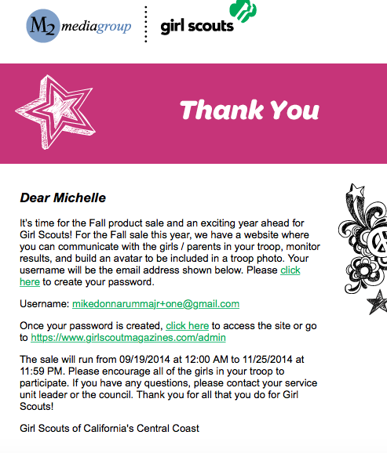
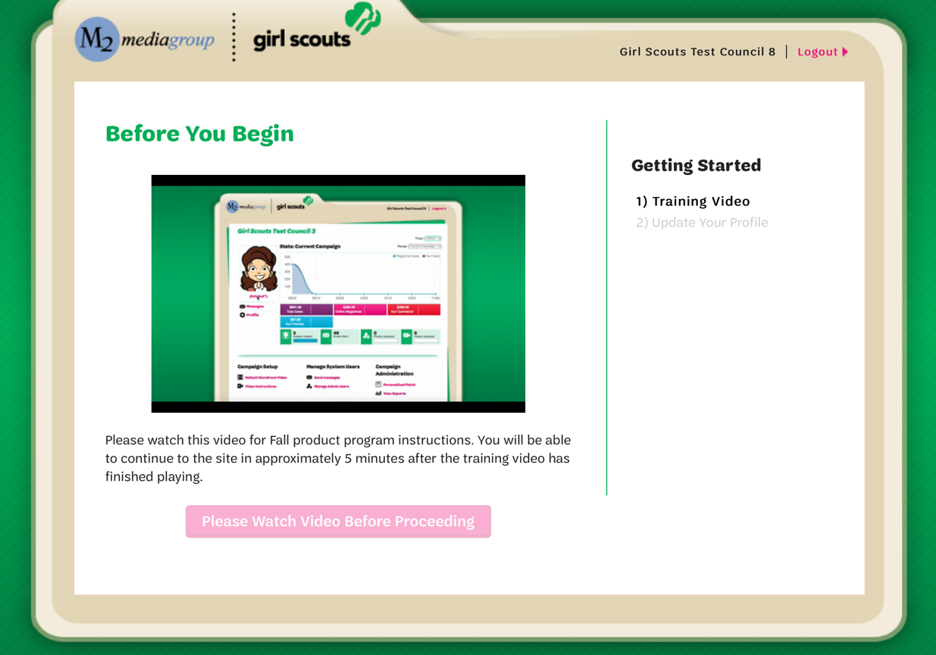
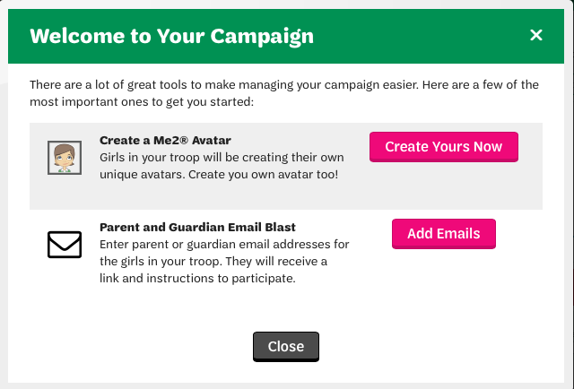

Welcome to Your Campaign
Prior to Fall Product Program start, volunteers receive email invitation to M2OS
To get started:
Watch troop training video
Create your troop leader avatar
Within M2OS, launch parent/guardian email blasts announcing troop participation in the Fall Product Program
Manage nut card orders (after girl entry for any girls who didn’t enter their own paper orders)
View reports

Slide 3
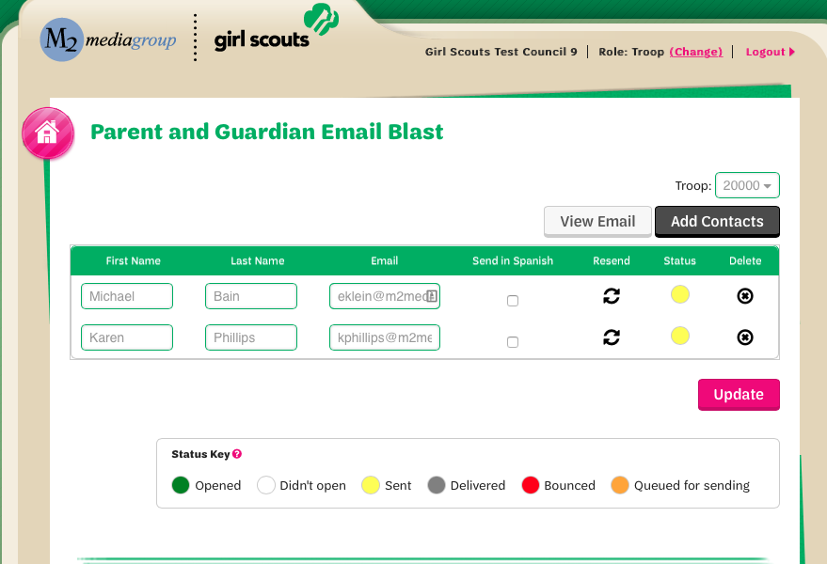
Parent and Guardian Email Blast
Troop leaders can launch an email directly to parents with a link and instructions on how to participate
Parent email addresses will be uploaded by council
Volunteers can edit or enter any missing parent/guardian emails
The Parent/Guardian Email Blast has a 72% open rate - the EASIEST way to get your girls to participate online!

Slide 4
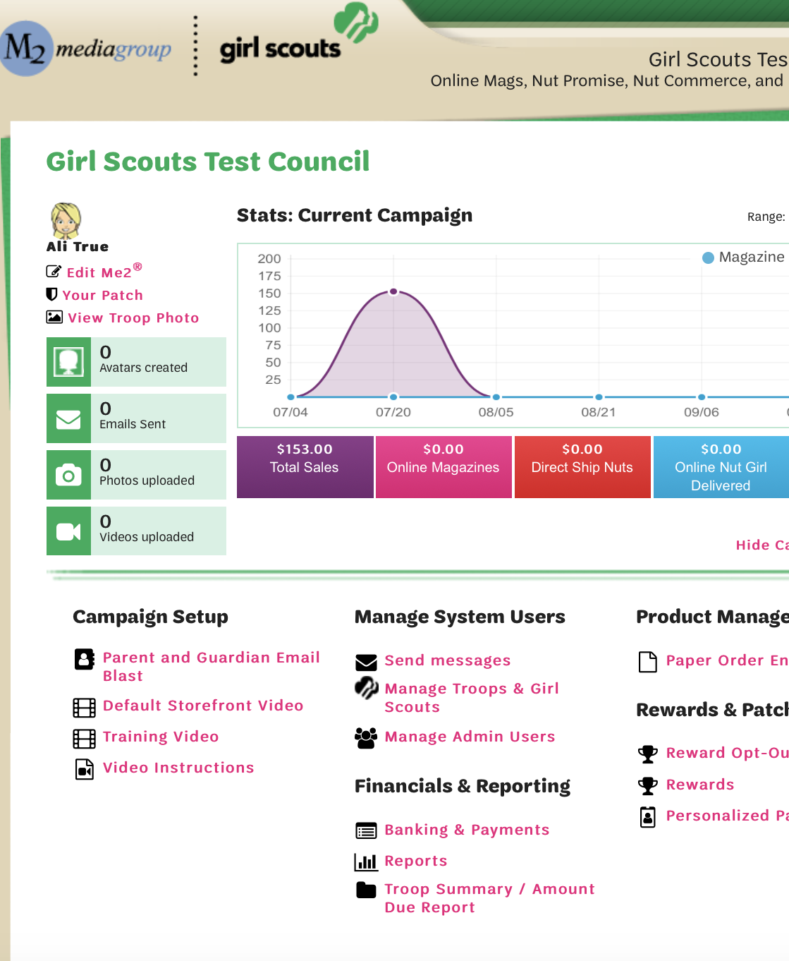
Troop Campaign Headquarters
Headquarters for managing a troop campaign
All program management tools on one site

Slide 5
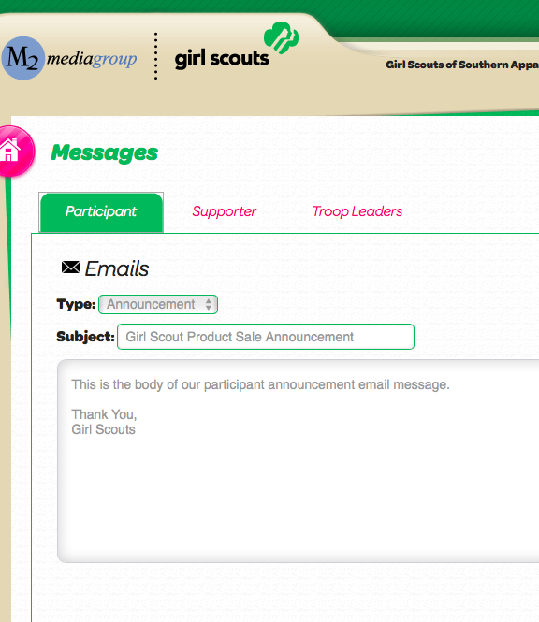
Messaging Through M2OS
Contacting specific participants, troops and supporters
  Troop to Girl – Announcement, Registered but not Launched, Thank You
  SU to Troop – Everyone, Only those not Logged In, Only those Logged in

Slide 6
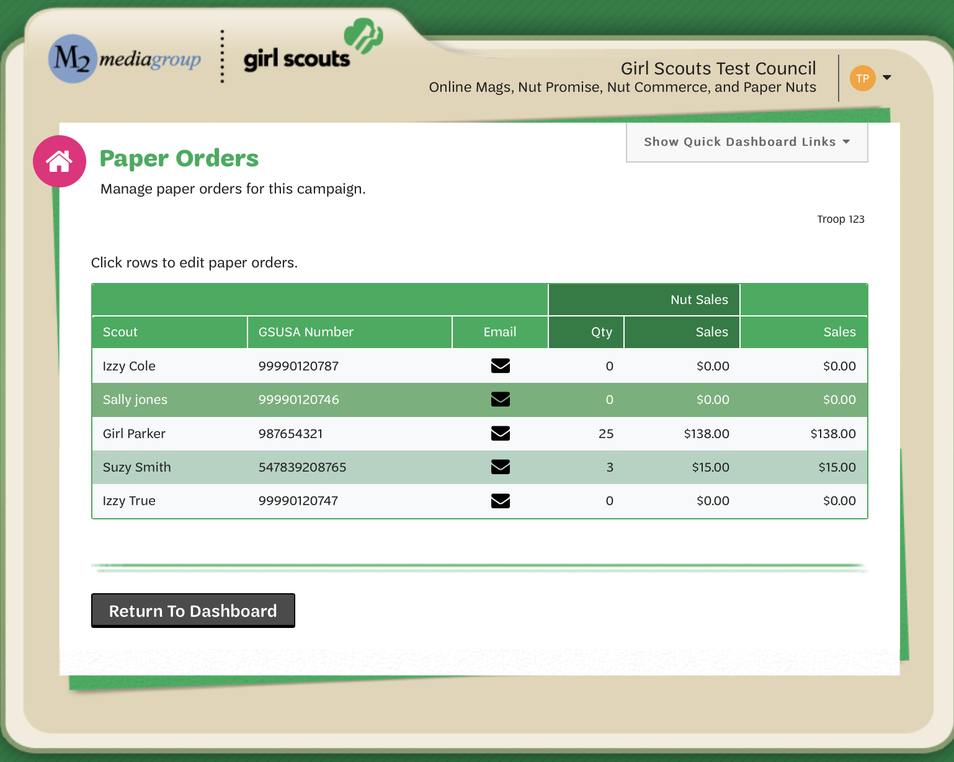
Entering In-Person Nut Order Card Items
Select the Girl Scout’s name to edit her orders
Click “+Add Girl Scout” to add orders for any girls missing from the list
Message girls directly with questions about items entered

Slide 7
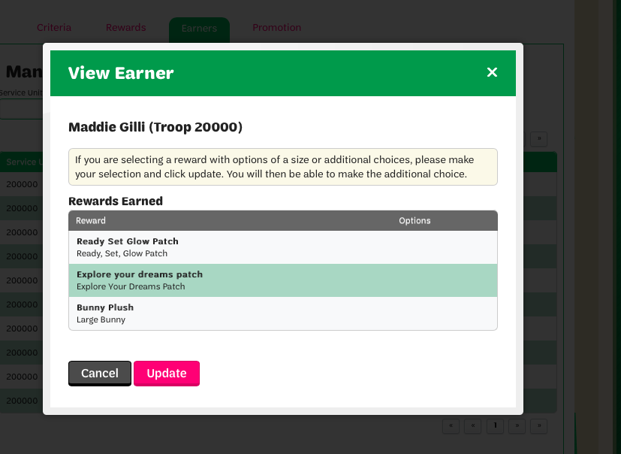
Girl Rewards
Rewards are automatically calculated for girls
To view rewards, choose the Rewards link from the Troop Dashboard
If girls didn’t make choices, volunteers can make reward selections for them
Detailed reports of earned rewards available under Reports link or through the Delivery Tickets link

Slide 8
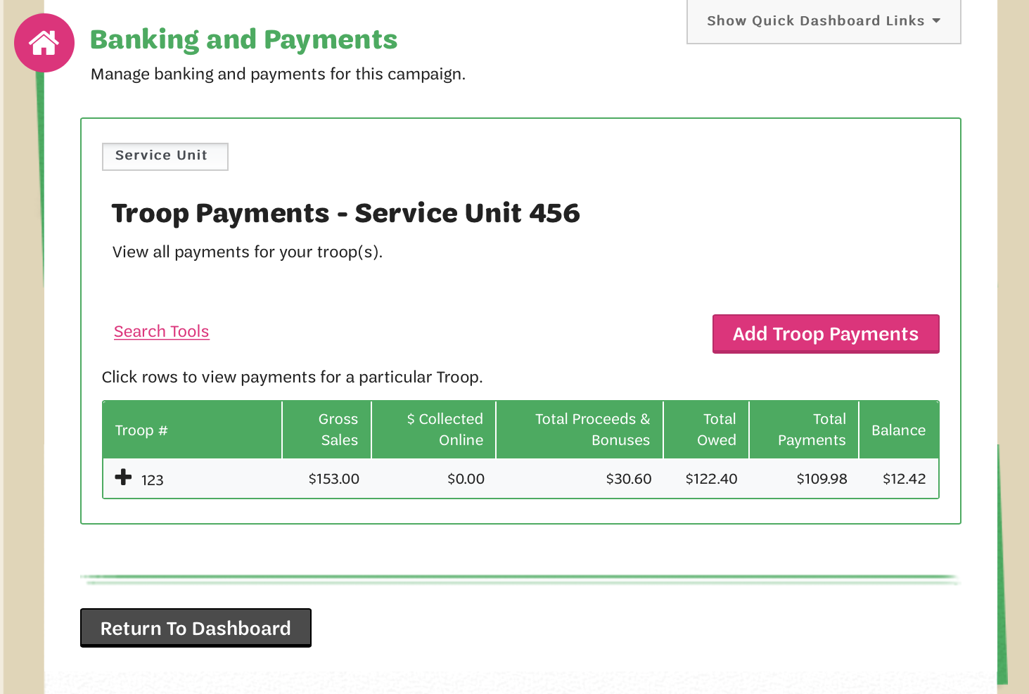
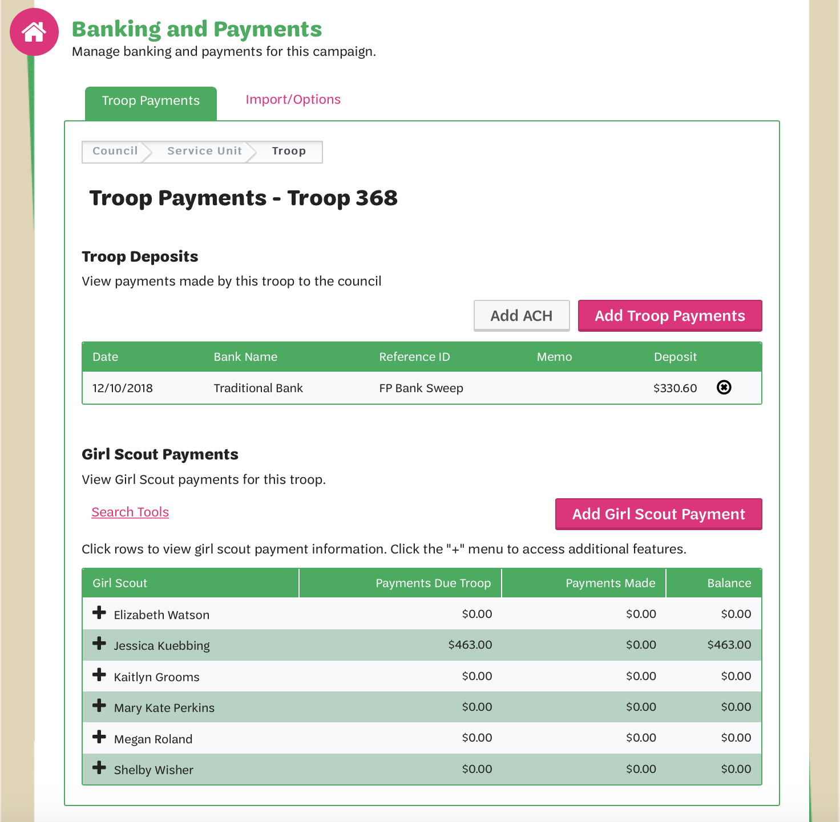
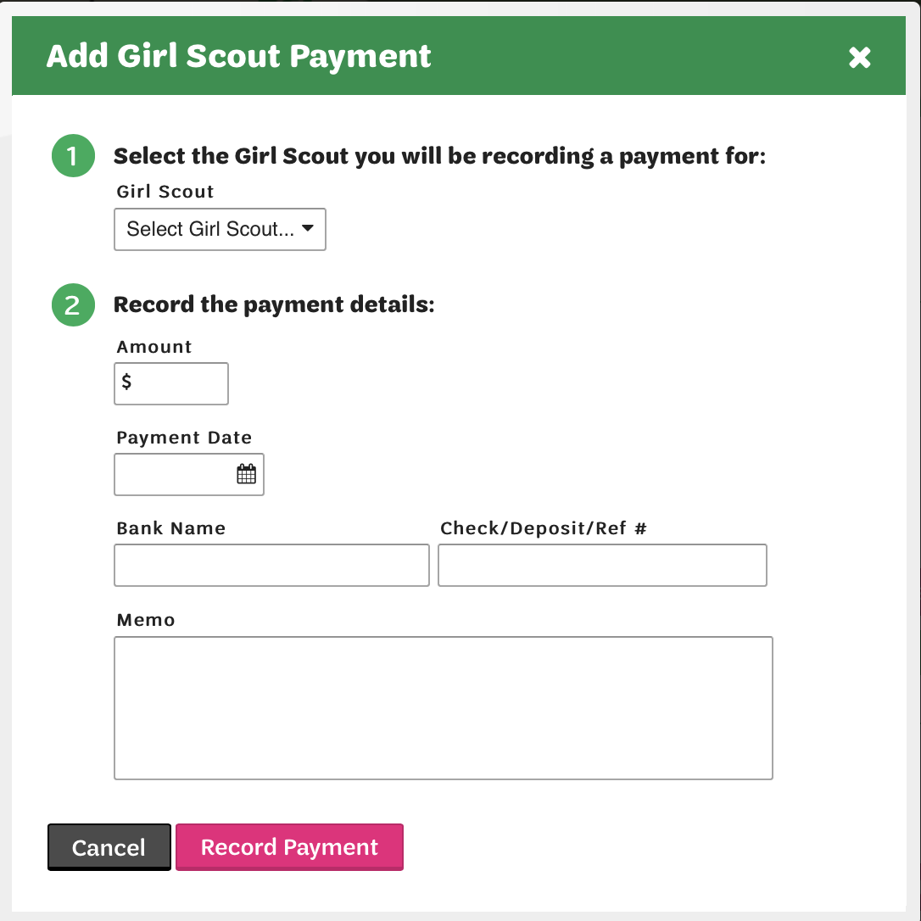
Troop Banking & Payments
View troop financial information at a glance including:
  Gross sales
  Total paid online by customers
  Total proceeds earned
  Balance due council
  Girl payments (if entered by troop)

Slide 9
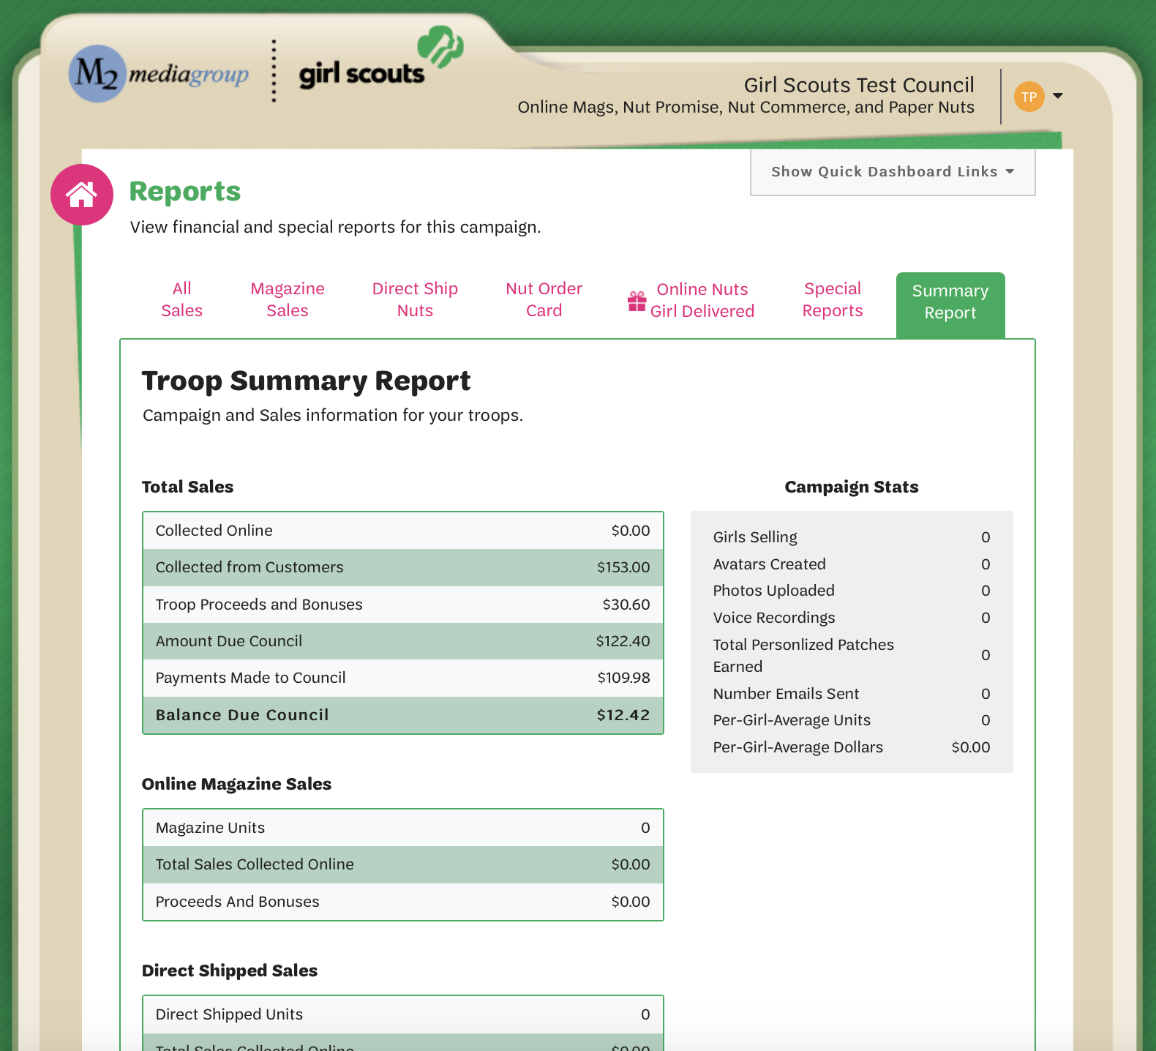
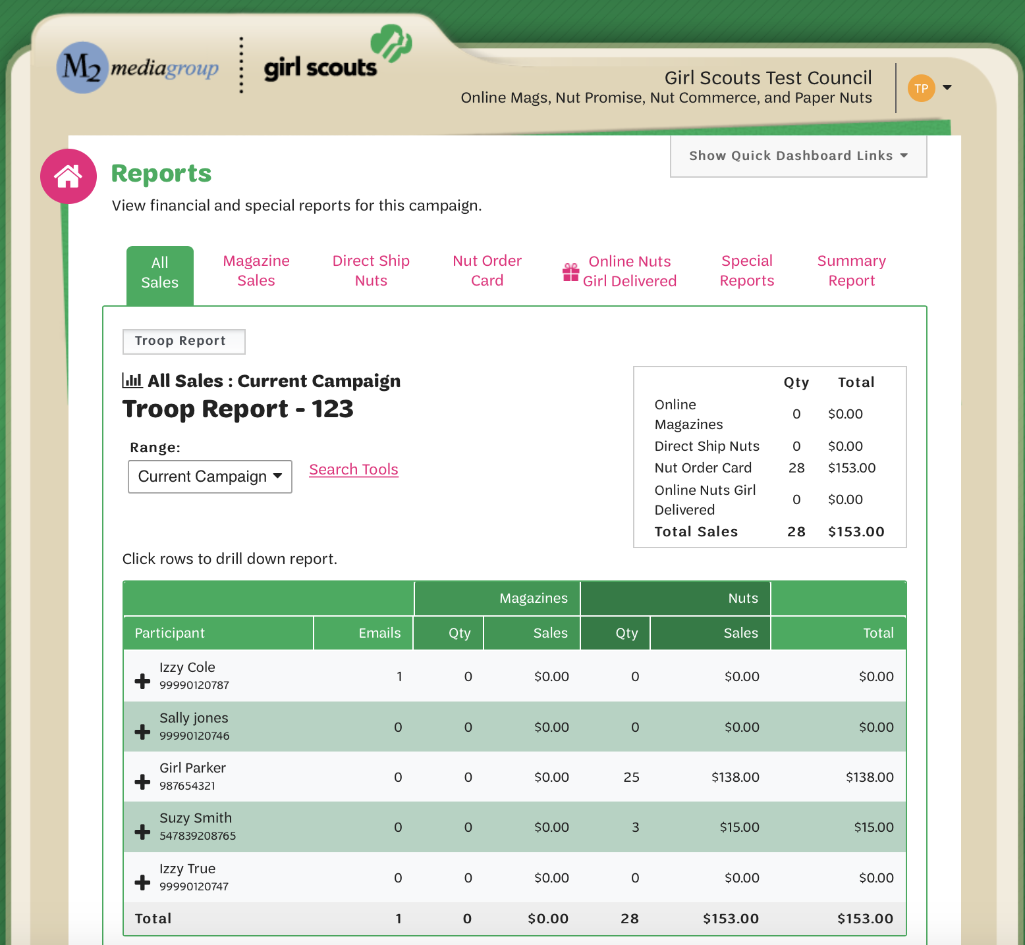
Reports
Click the Reports link from the Troop Dashboard to view total sales or sales by product category
Click a girl name to view the specific details of individual girls
Link on dashboard Troop Summary/Amount Due Report

Slide 10
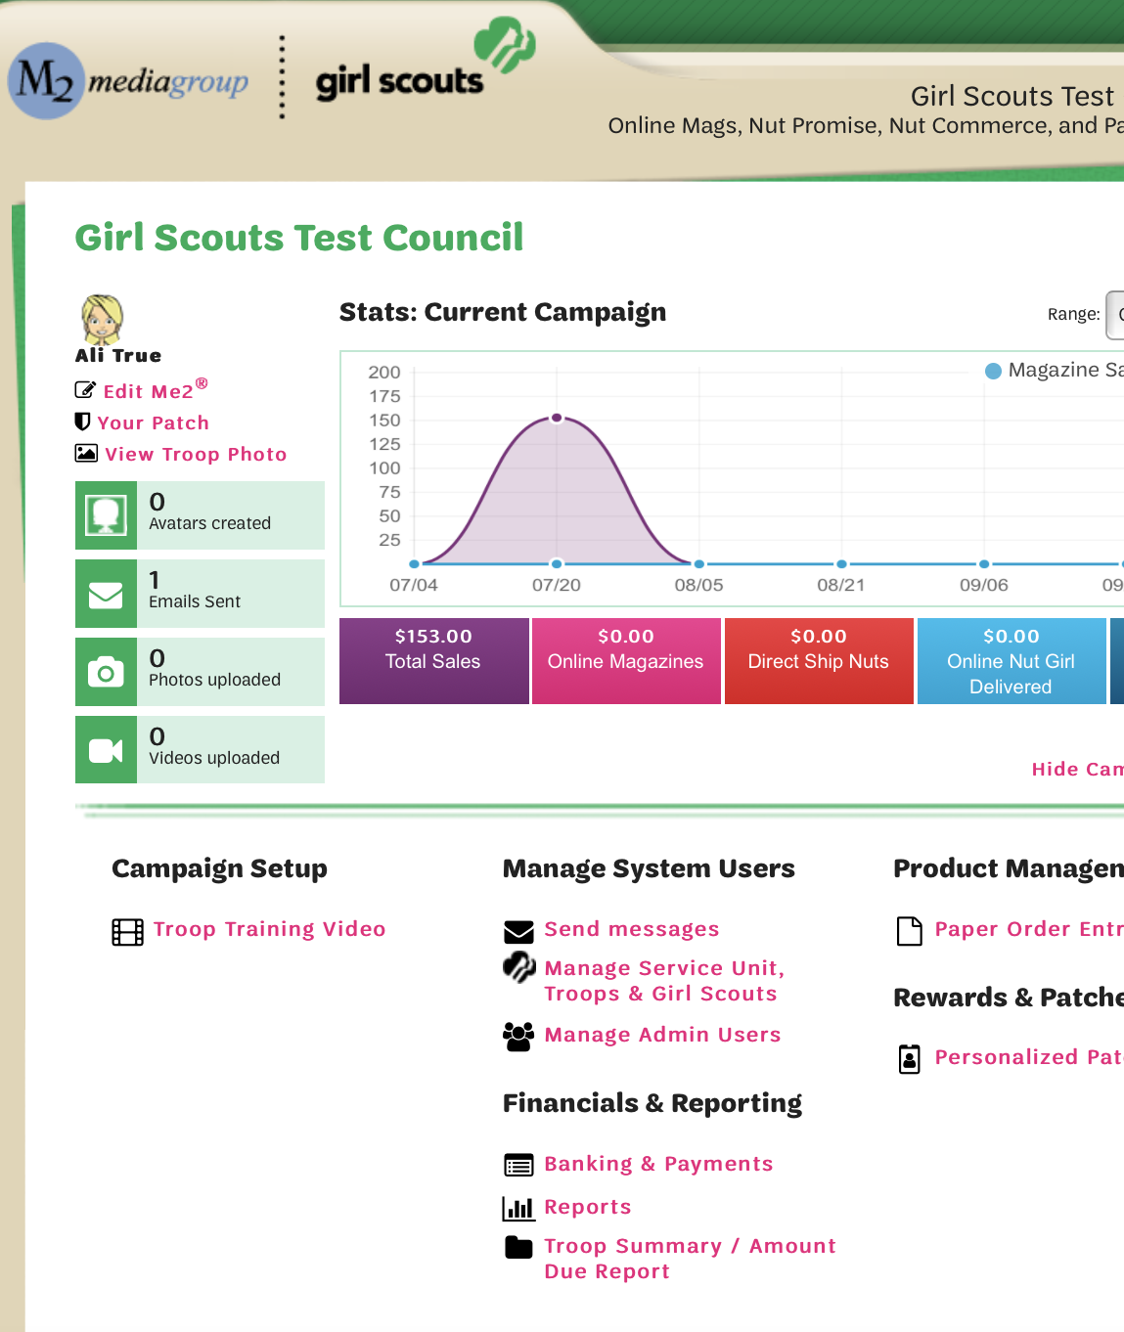
Service Unit Dashboard
Send messages to troops
Manage troop admin users
Manage/edit girl and troop products
View troop financials and payments made to council
Troop sales summaries
Delivery tickets

Slide 11
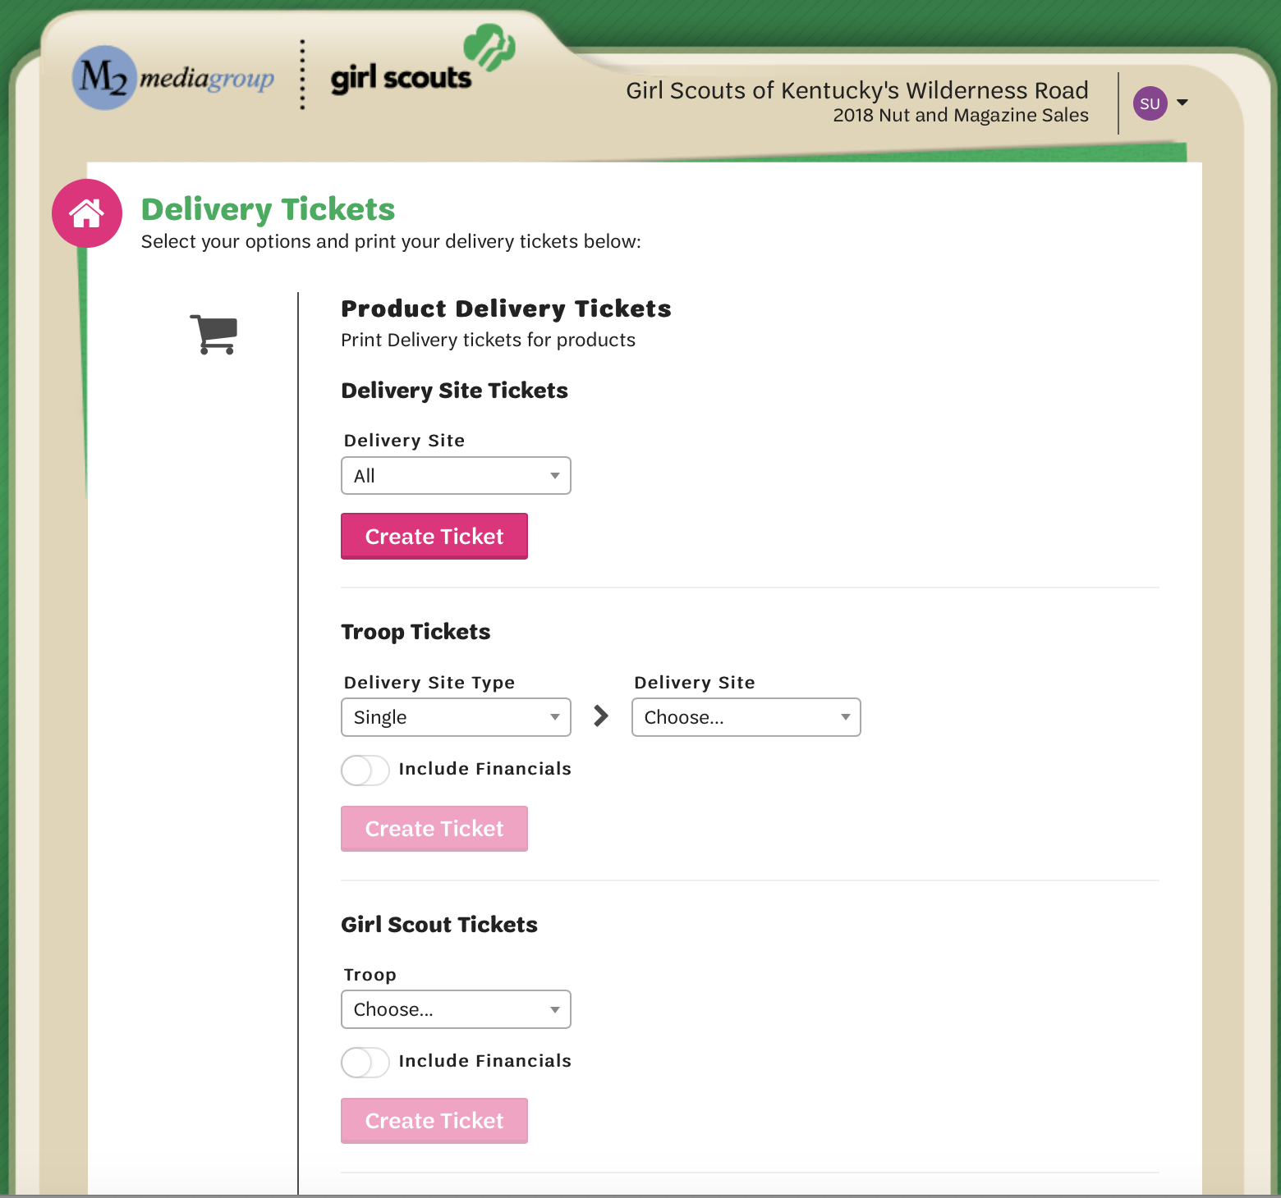
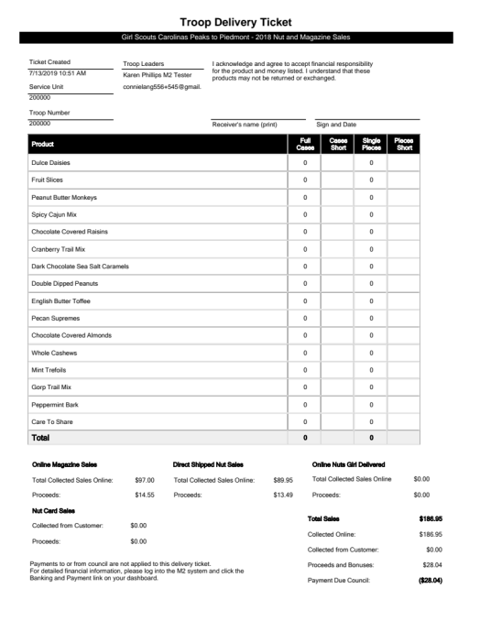
Delivery Tickets
Print delivery tickets by SU, troop or girl
Available for products and rewards for easier picking and packing
Option to include financials

Slide 12
Safety first
The safety of our girls, families and volunteers is our number one priority
For delivery of products and rewards, please follow the CDC, local, state, county, city and GSCP2P guidelines

Slide 13
Me2® Volunteer Patch
Troop Fall Product Chairs
Earned by achieving $750 in total Troop sales
Service Unit Product Chairs
Earned for $1 in total Service Unit sales

Slide 14
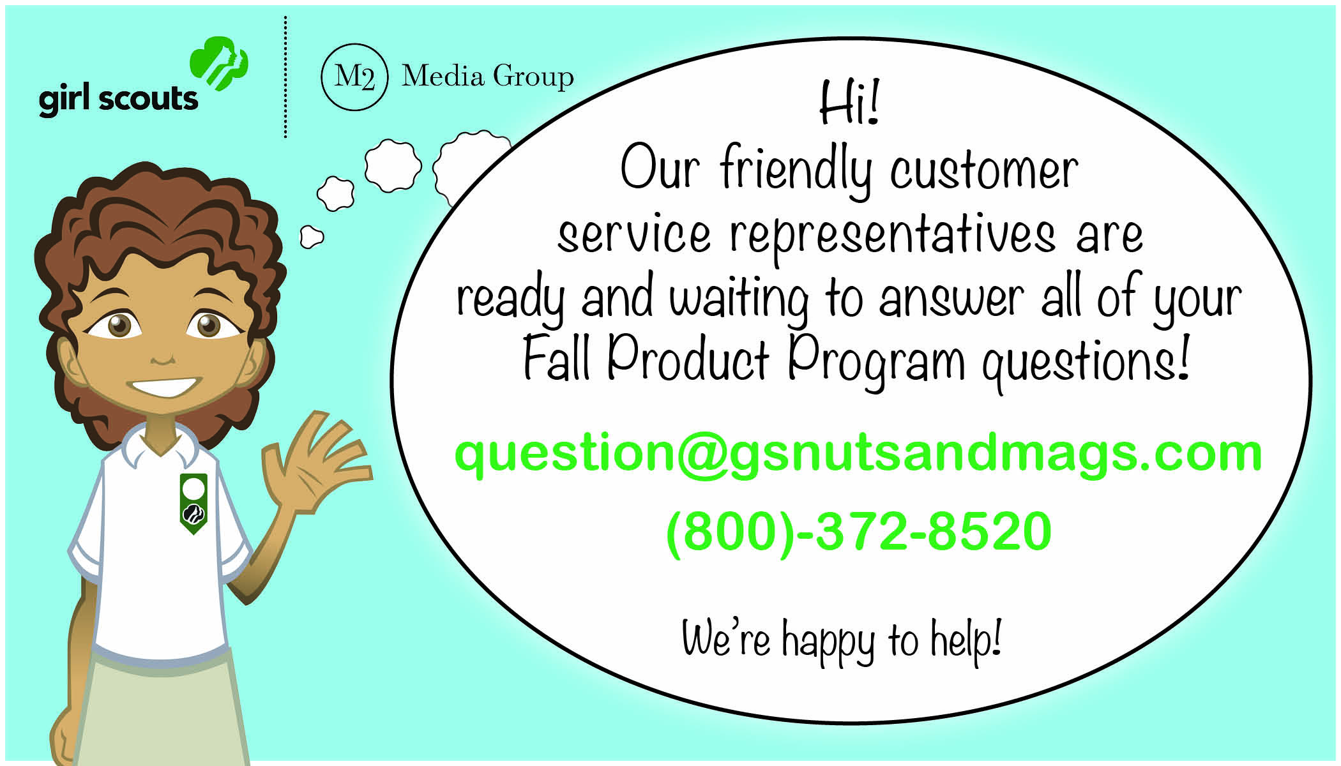
Fall Product Program
Customer Care
M2’s Customer Care team is cross-trained to handle tech support, volunteer/participant and customer inquiries
100% customer satisfaction guarantee

