Slide 1











Girl Online Experience
Create a virtual likeness
  Creating avatars makes participating fun and get results with PATENTED Girl Scout platform
Notes:
Zip: 96910

Slide 2
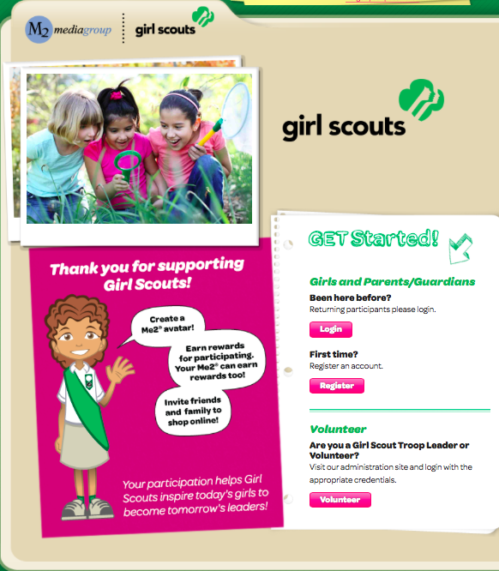

Getting Started
Girls log in as a first-time participant or as a returning user from last year
Spanish experience available

Slide 3
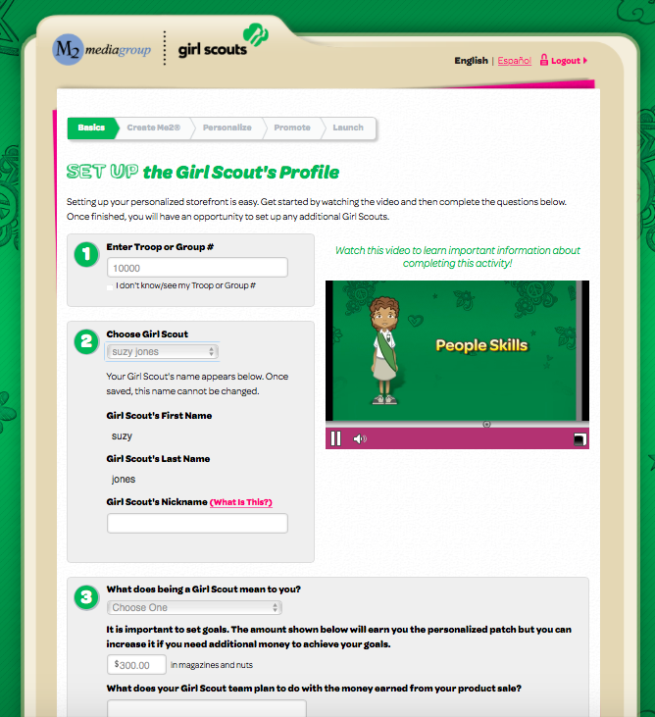
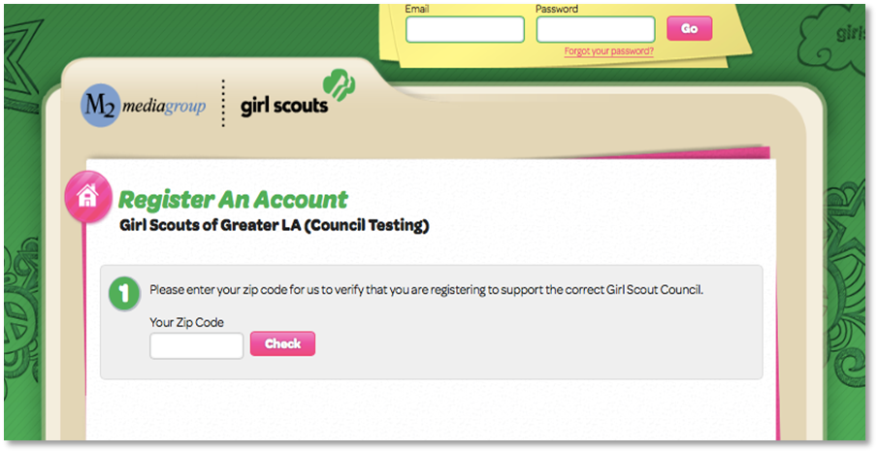
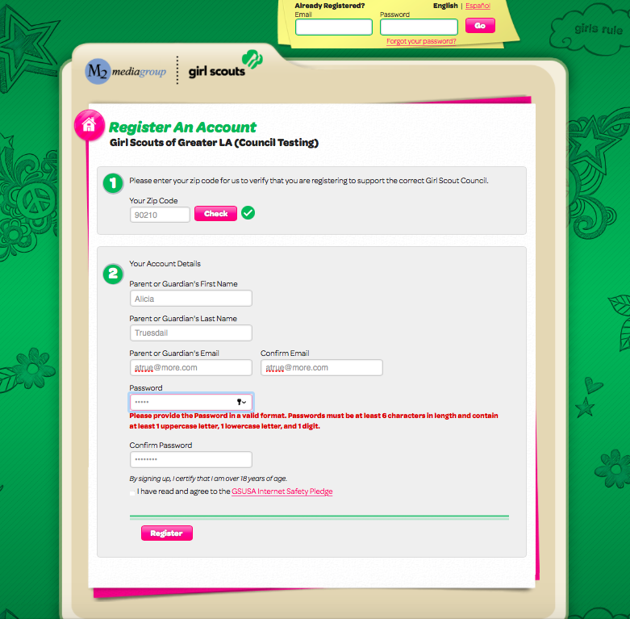
Registering an Account
Zip code validation ensuring girl in correct council
Troop number selection or “I don’t know/see my Troop#/Group#”
Participant can edit nickname
Answer questions about girl goals and what Girl Scouting means to her
Participant information and secure password setup

Slide 4
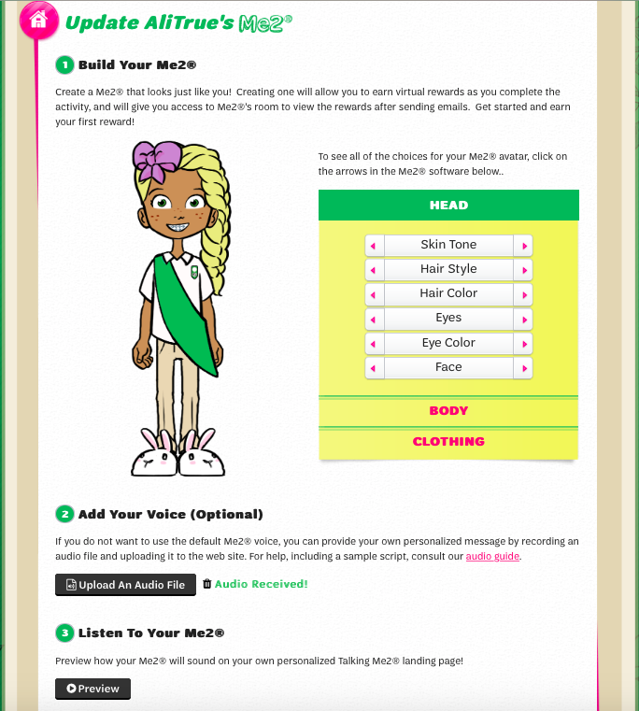

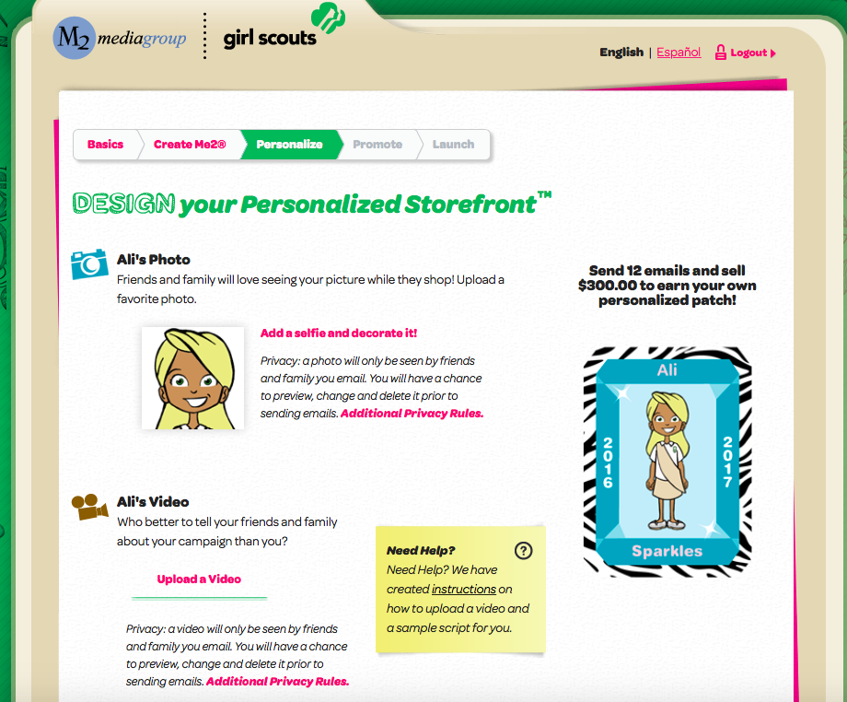

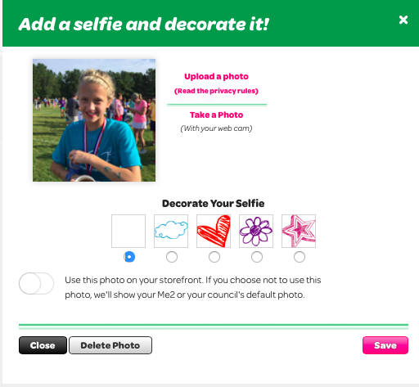
Personalize Her campaign
Avatar
Girl designs her own virtual likeness choosing from over 3 billion avatar feature combinations
Upload a photo or video to share on your storefront
Earned by sending15 e-mails and sell 4+ magazines and 20+ nut/chocolate items

Slide 5
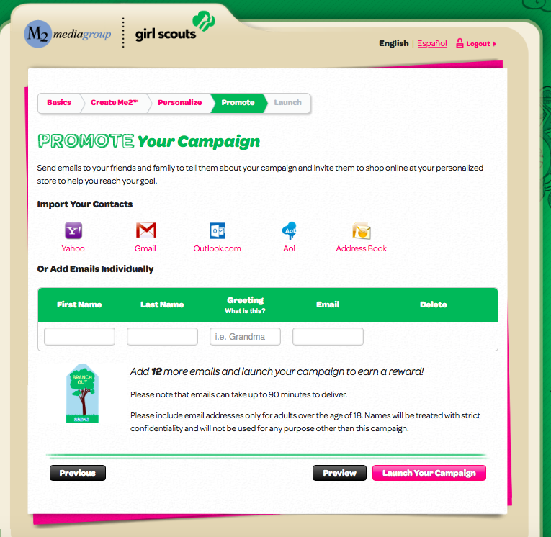
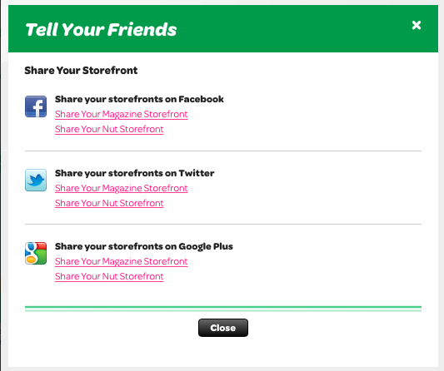
Promoting Her Campaign
Girls share their online storefront link with family and friends by sending emails or sharing on social media
    27% of online sales come from social media
Girls also have business cards preprinted with their storefront code
  Take a picture of the business card and text family and friends.
Easier for returning girls with customer email addresses saved year over year
Option to include last name so friends and family know who is sending the email
Simplicity of one click renewals for customers previously purchasing magazines

Slide 6
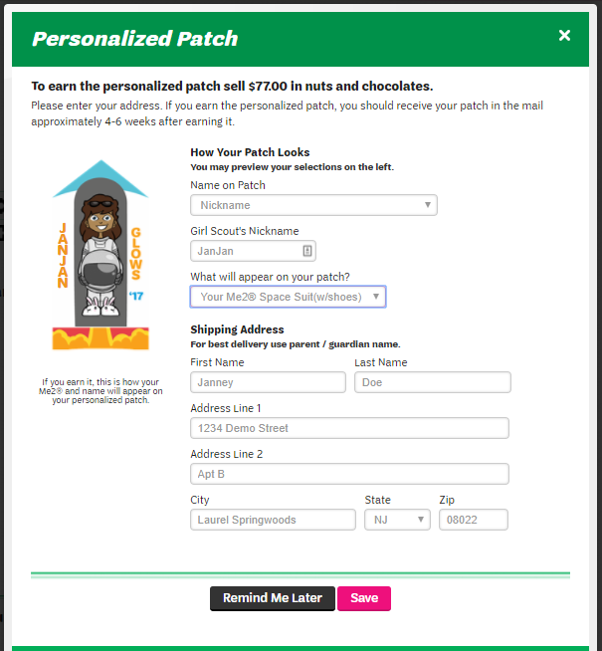
Personalized Patch Shipping
Girl chooses name, nickname or initials for her patch
Girl makes selection between two patch backgrounds
Opportunity to provide mailing address after login
Personalized patches ship directly to girls as earned throughout the program

Slide 7
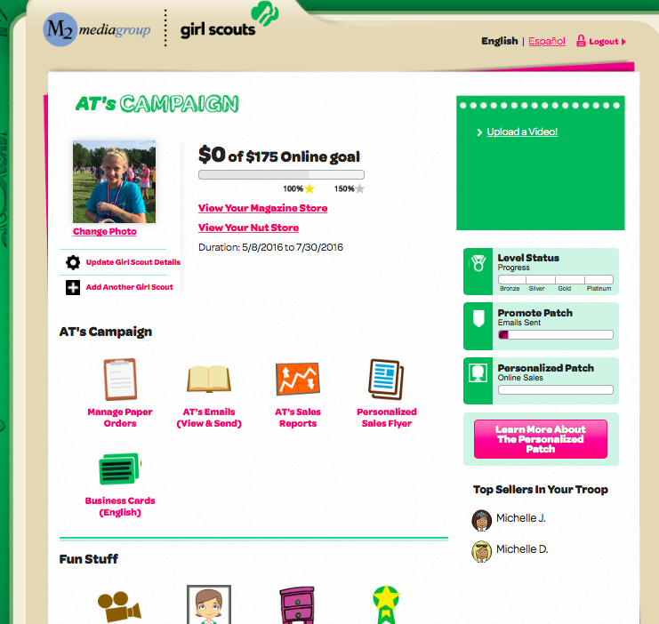
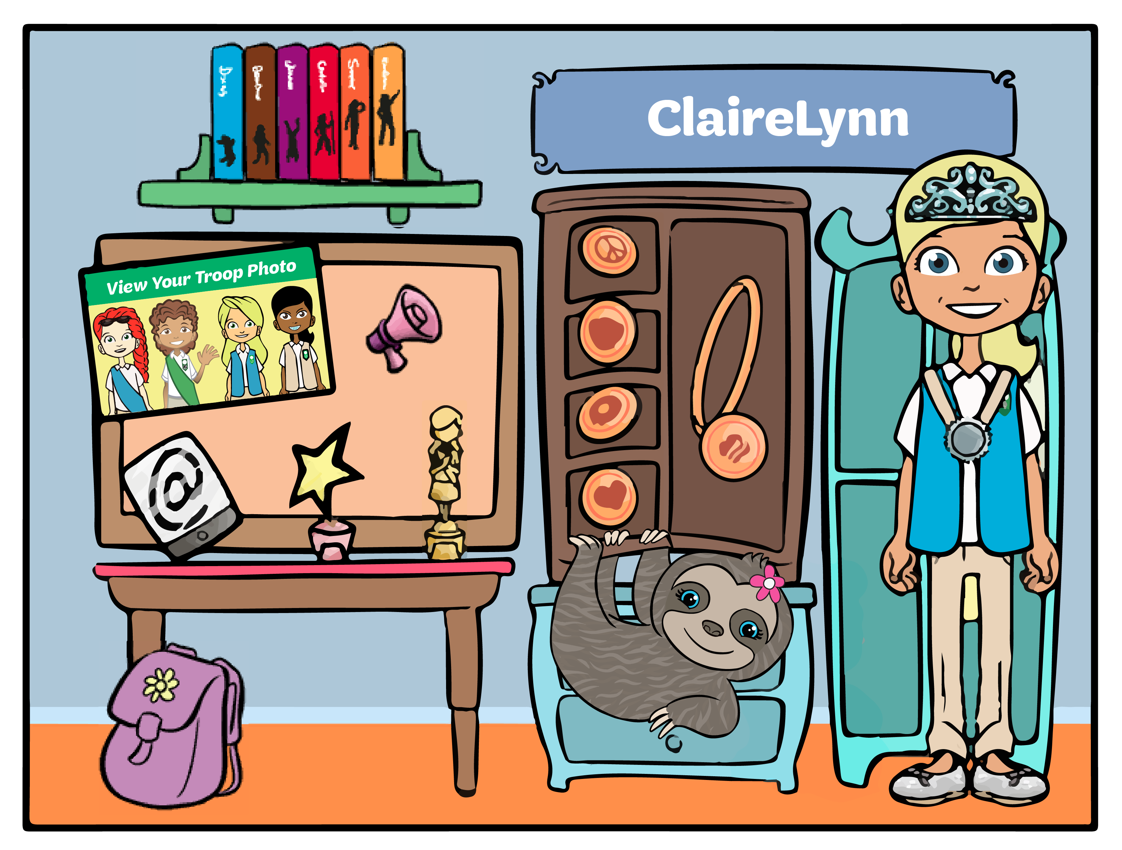
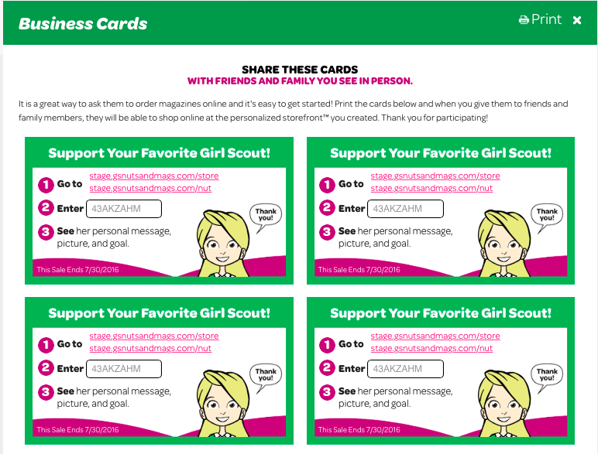
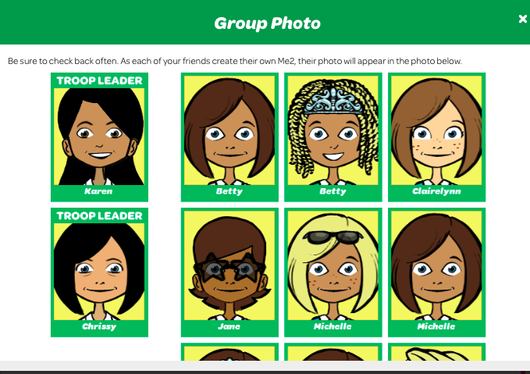
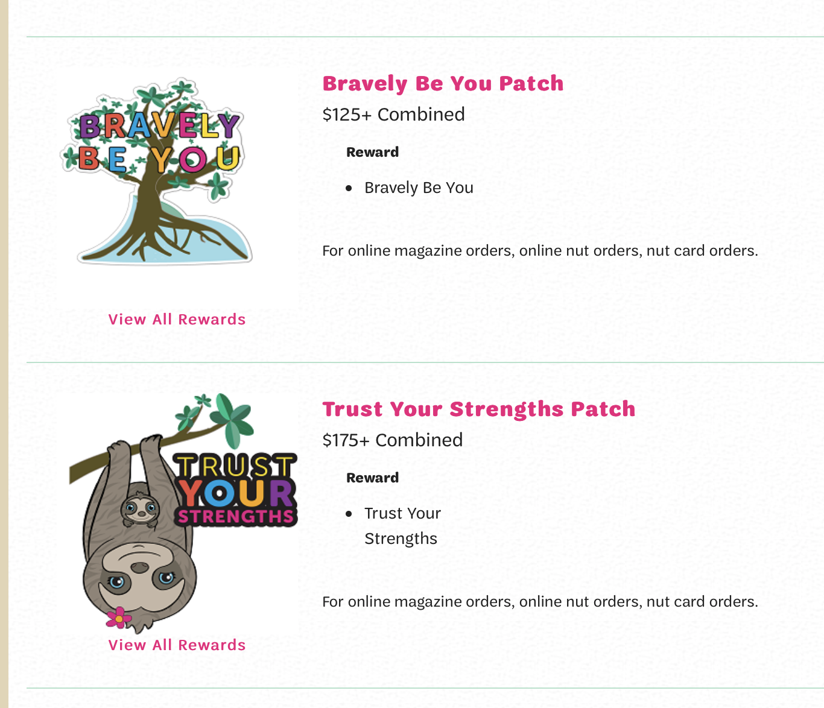
Girl’s Campaign HQ
Navigation tools for all aspects of the program
  E-mails/Social Media
  Printable business cards with girl’s online store code
  Manage paper orders (nut card sales entry)
  Rewards earned and actions need to receive rewards
  Reports
  Avatar’s room with troop photo

Slide 8

2020-21 Fall & Girl Scout Cookie Crossover Patch
As a Girl Scout member, girls work to create change and to become dynamic leaders
To earn this crossover patch, girls must:
  Participate in the 2020 Fall Product Program by creating an avatar and sending 15+ emails
  Sell 325+ packages of cookies during the 2021 Cookie Program

Slide 9
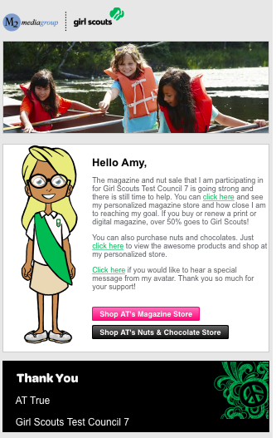
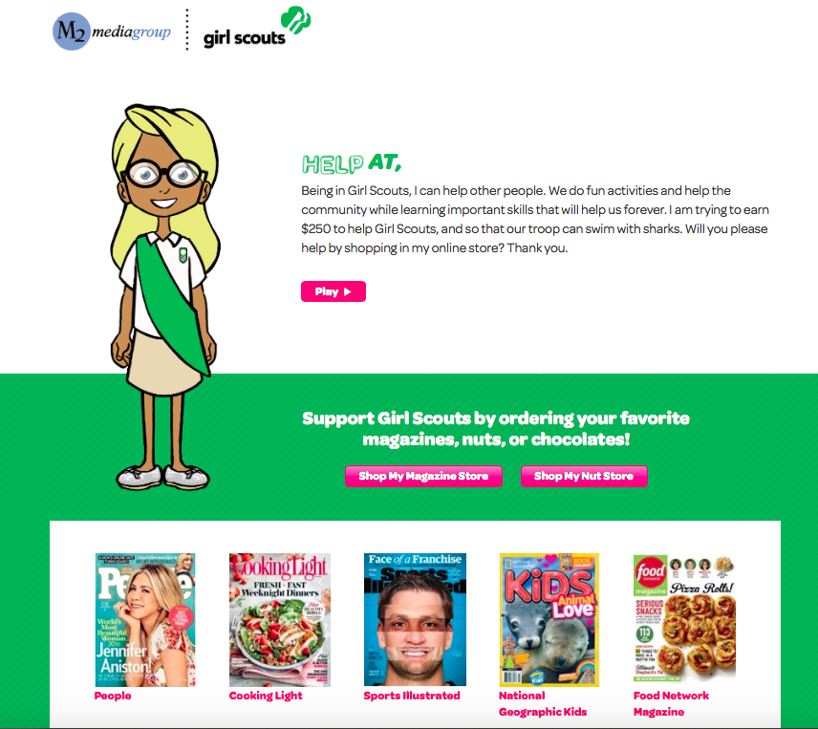
Customer Emails
Family and friends receive emails with links to shop for magazines and nuts/chocolates and can hear the special message recorded by their favorite Girl Scout

Slide 10
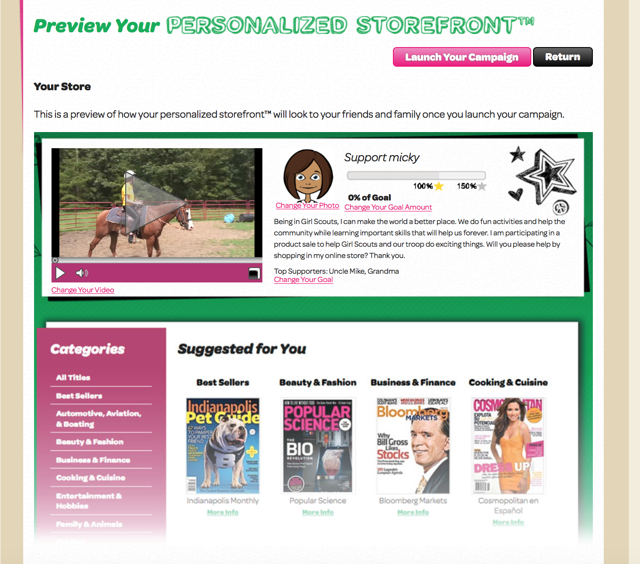
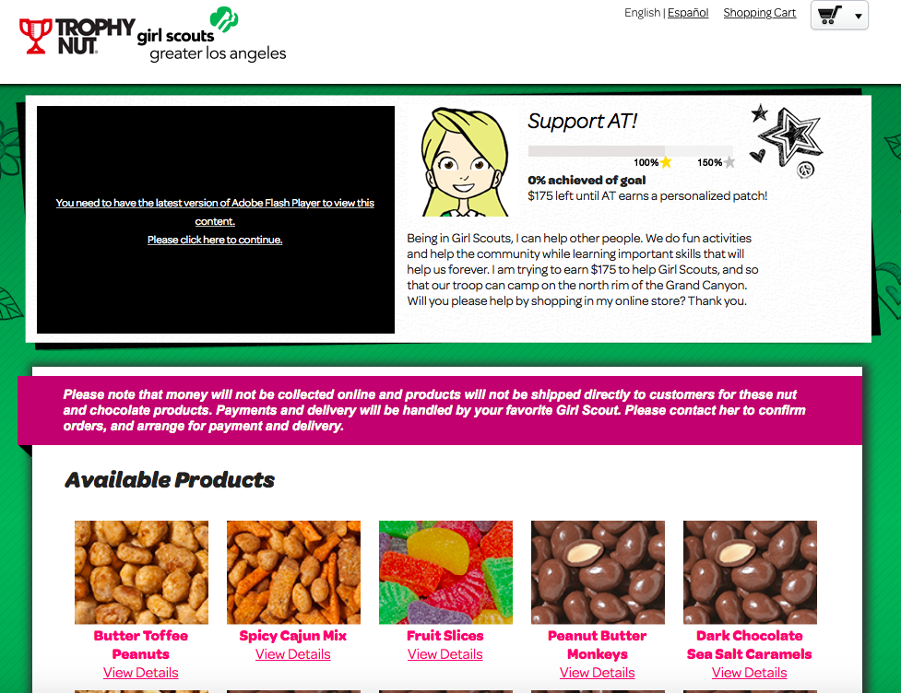

Online Storefronts
Magazine selections include all Time, Inc titles and Reader’s Digest

Slide 11
Online Nuts/Chocolates
Customers have the option to choose girl delivered or direct ship
Customers pay for all products online at the time of checkout

Slide 12
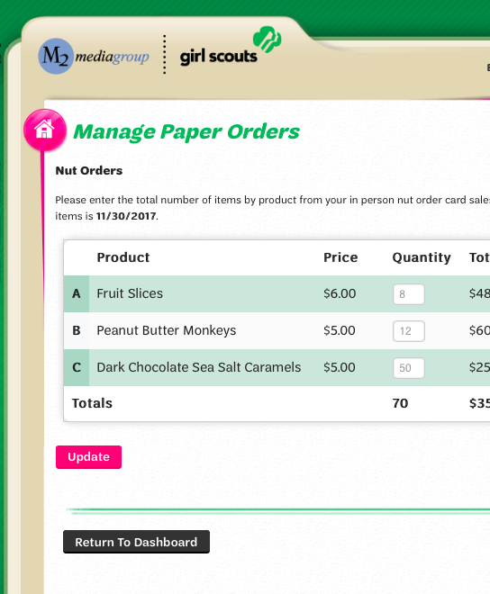
Entering
In-Person Nut Order Card Items
Parents/girls enter the total of each item using the nut order card into the M2OS system prior to the end of the program
Nut order card totals will be tabulated and added to all online sales totals in reports
All in-person nut orders must be entered into M2OS system to be processed

Slide 13
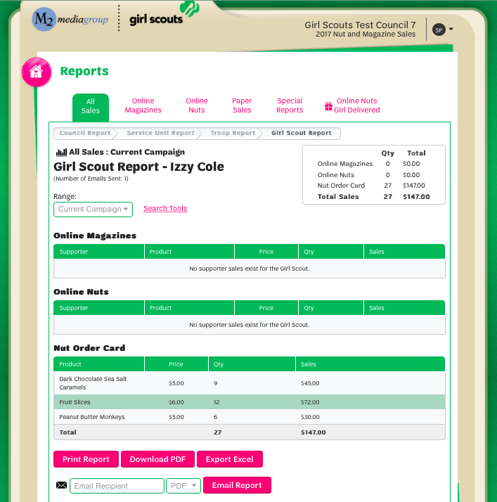
Reports
Reports broken out by sales categories
View all girl delivered items sold online by customer to see which products to deliver
Report emailed to parents at end of program

Slide 14

Fall Product Program
Customer Care
M2’s Customer Care team is cross-trained to handle tech support, volunteer/participant and customer inquiries
100% customer satisfaction guarantee

